Slide 1

INTRODUCTION
Presented By:
Md. Juel Rana
ID: 221002492
Department of CSE
Presented To:
S.M. Rashidul Hasan Nijhum
Lecturer
Department of CSE

Slide 2
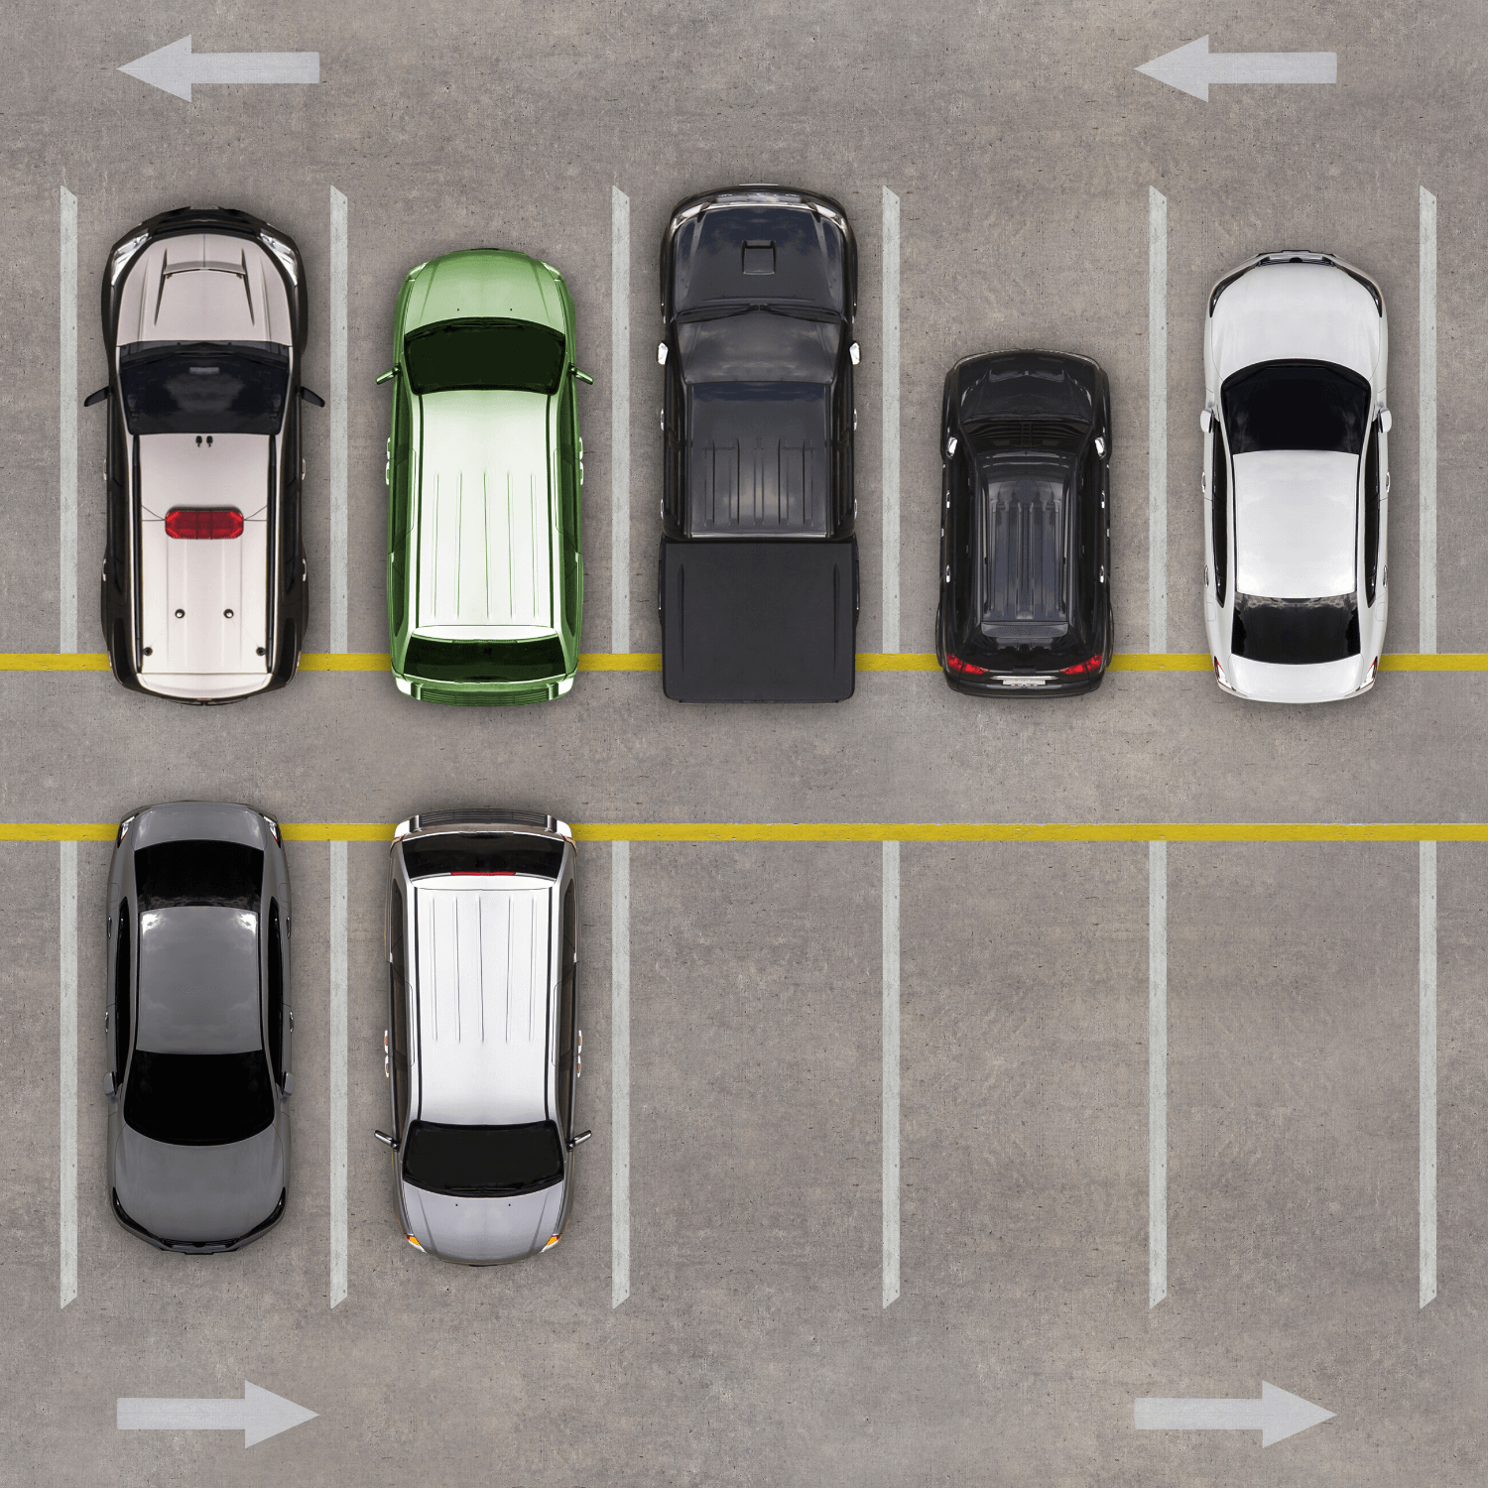
VEHICLE PARKING MANAGEMENT SYSTEM

Slide 3


Content
01
05
What is Parking Management
System ?
Implementation
02
06
Objective
Advantage & Disadvantage
& Application
03
07
Project Features And Project Architecture
Future Scope
04
08
Conclusion
Tools/Platform

Slide 4

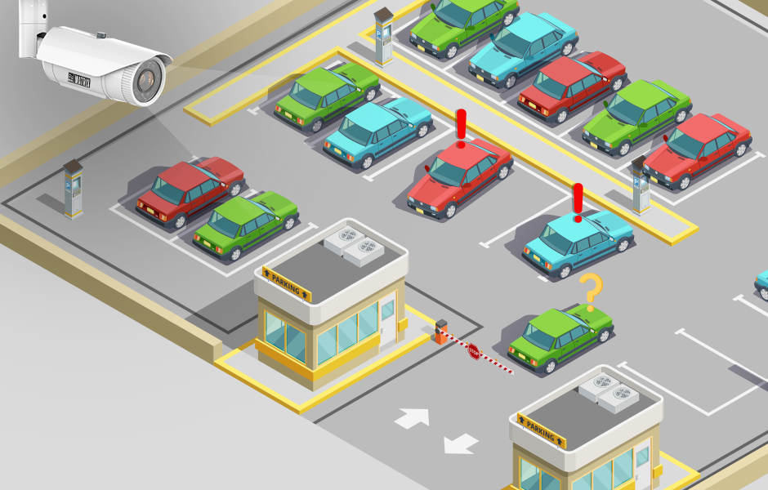
Vehicle Parking Management System
Parking management system for managing the records of the incoming and outgoing vehicles in an parking house.
It’s an easy for Admin to retrieve the data if the vehicle has been visited through number he can get that data.

Slide 5
OBJECTIVE
01
To Maintain records in short time period.
02
To Easy operation for operator of the system.
03
To Reduce time consumption.
04
To Determines the parking area is full or not.
05
No paper work requirement.

Slide 6
Project Features
01
Parking Vehicle
02
Check Vehicle
03
Checkout Vehicle
04
Total Insight
05
Exit

Slide 7
Project Architecture
START
MENU
for 1
for 2
for 3
for 4
for 5
Park Vehicle
Check Vehicle
Checkout Vehicle
Total Insight
Exit
End

Slide 8
(Cont.)
Park Vehicle
For 1
For 2
For 3
For 4
Bus
Car
Bike
Auto
1. Enter Your Name
2. Enter Your Vehicle Number
3. Enter Today Date
Enter Your Fees
If fees==slot price
If fees!=slot price
Menu
Park Vehicle

Slide 9
(Cont.)
Check Vehicle
1. Enter Your Name
2. Enter Your Vehicle Number
3. Enter Date
If Any one false
If Three are True
Your Vehicle Available here
Sorry ! Your vehicle Not available here
Menu

Slide 10
(Cont.)
Checkout Vehicle
For 1
For 2
For 4
For 4
For 5
Bus
Car
Bike
Auto
Exit
Enter Your Slot Number
Menu
If no
If yes
Vehicle Checkout Successfully
Menu
Slot Number empty

Slide 11




TOOLS/PLATFORM
Laptop
Windows 11
01
02
Code blocks
‘C’ Language
03
04

Slide 12

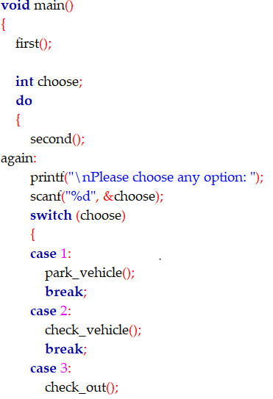
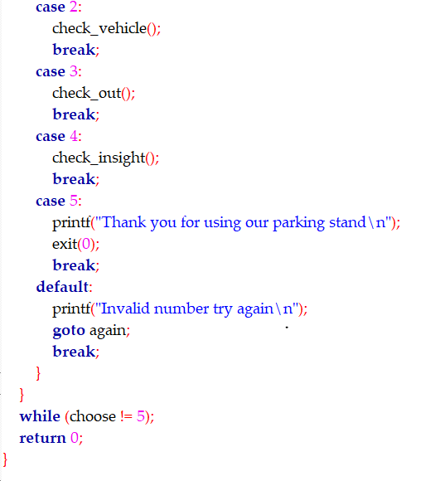
Implementation

Slide 13
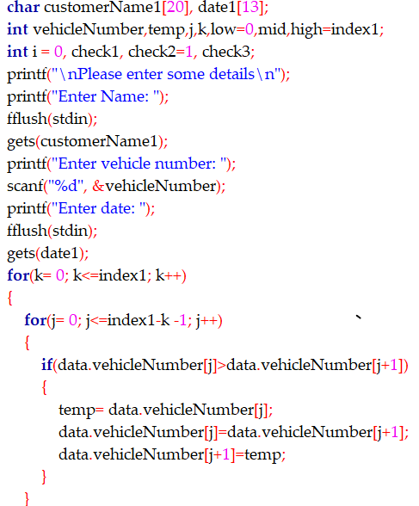
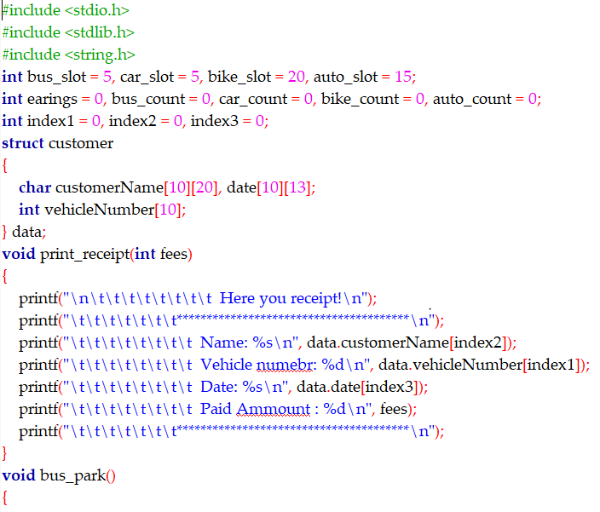
(Cont.)

Slide 14
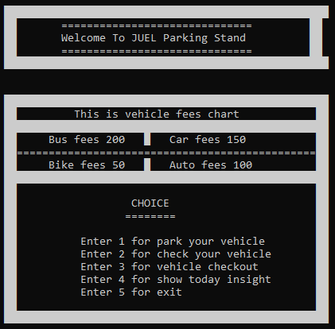
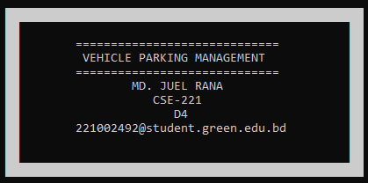
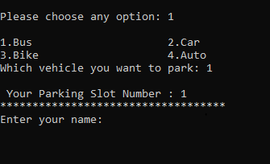
SOME OUTPUT

Slide 15
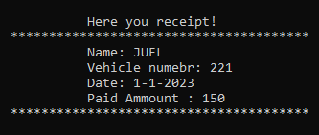
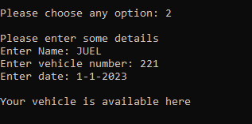
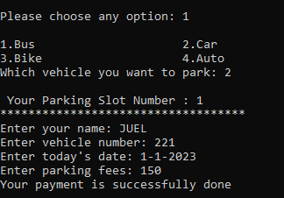
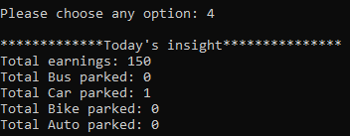
(Cont.)

Slide 16
ADVANTAGE
Better parking experience.
01
02
Easy to manage and cost-effective.
03
Reduced traffic and pollution.
04
Increased Protection.
05
Safe and Squired.

Slide 17
DISADVANTAGE
01
Data not store permanently.
02
Data entry employed needed.
03
Minimum Limited car parking slot.

Slide 18
APPLICATION
01
Enterprises and institution.
02
Market place.
03
Plaza.
04
Hospital.
05
Factory.

Slide 19
Future Scope
In the modern age. Many people have vehicles. Vehicle is now a basic need. Everyplace is under the process of urbanization. There are many corporate offices and shopping centers etc. There are many recreational places where people used to go for refreshment. So, all these places need a parking space where people can park their vehicles safely and easily.

Slide 20


Conclusion
This Project is minimizing the task of parking a vehicle by paying and saying some details about customer and vehicle to save data .In this the vehicle is parked as a safe and secure. This project is done as Efficient as possible.

Slide 21
Thank
YOU.

